Slide 1
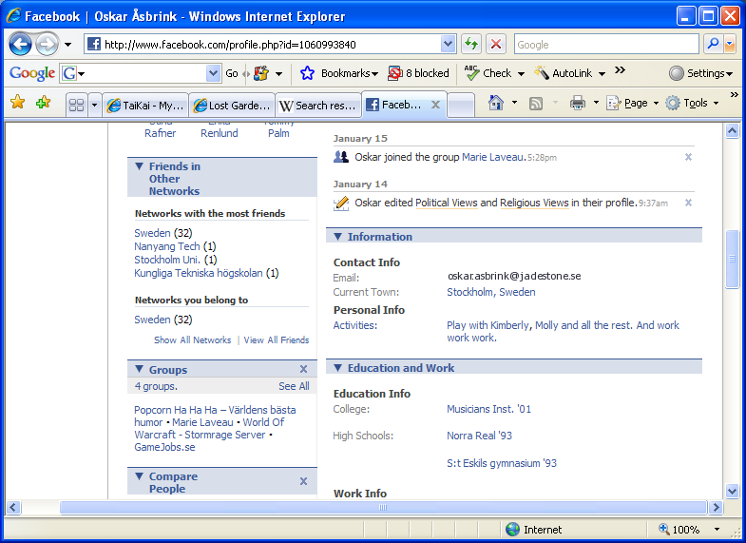
Awesome Adventures
Fighter
adventure
inventory
party
Power: 232
Select adventure
The
cave
Boss
Battle
Defend
Town
Hunt
Monsters
Event log
Power: 32

Slide 2
Awesome Adventures
Fighter
adventure
inventory
Give to
a Friend
Drop Item
Gold: 532
Event log
Power: 32

